Slide 1
CHANNEL CODING

Slide 2
Channel Coding
Why?
To increase the resistance of digital communication systems to channel noise via error control coding
How?
By mapping the incoming data sequence into a channel input sequence and inverse mapping the channel output sequence into an output data sequence in such a way that the overall effect of channel noise on the system is minimised
Redundancy is introduced in the channel encoder so as to reconstruct the original source sequence as accurately as possible.

Slide 3
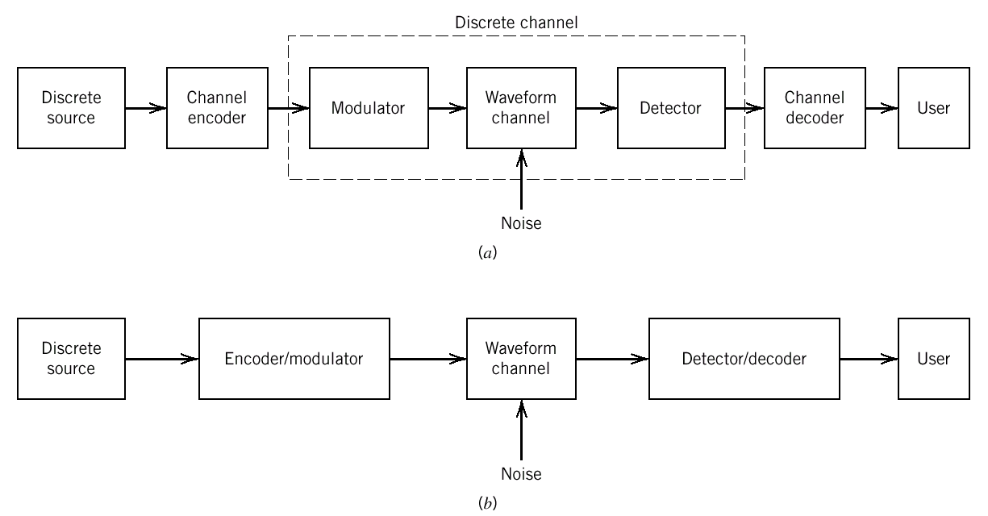
Error Control Coding
Error control for data integrity may be exercised by means of forward error correction (FEC).
The discrete source generates information in the form of binary symbols.
The channel encoder accepts message bits and adds redundancy to produce encoded data at higher bit rate.
The channel decoder uses the redundancy to decide which message bits were actually transmitted.
What is the implication?

Slide 4
The implication of Error Control Coding
Addition of redundancy implies the need for increased transmission bandwidth
It also adds complexity in the decoding operation
Therefore, there is a design trade-off in the use of error-control coding to achieve acceptable error performance considering bandwidth and system complexity.
Types of Error Control Coding
Block codes
Convolutional codes

Slide 5
Block Codes
Usually in the form of (n,k) block code where n is the number of bits of the codeword and k is the number of bits for the binary message
To generate an (n,k) block code, the channel encoder accepts information in successive k-bit blocks
For each block add (n-k) redundant bits to produce an encoded block of n-bits called a code-word
The (n-k) redundant bits are algebraically related to the k message bits
The channel encoder produces bits at a rate called the channel data rate, R₀
Where R_{s} is the bit rate of
the information source
and n/k is the code rate

Slide 6
Linear Block Codes
An (n,k) block code indicates that the codeword has n number of bits and k is the number of bits for the original binary message
A code is said to be linear if any two code words in the code can be added in modulo-2 arithmetic to produce a third code word in the code
Code Vectors
Any n-bit code word can be visualised in an n-dimensional space as a vector whose elements having coordinates equal the bits in the code word
For example a code word 101 can be written in a row vector notation as (1 0 1)
Matrix representation of block codes
The code vector can be written in matrix form:
A block of k message bits can be written in the form of 1-by-k matrix
Modulo-2 operations
The encoding and decoding functions involve the binary arithmetic operation of modulo-2
Rules for modulo-2 operations are…..

Slide 7
Modulo-2 operations
The encoding and decoding functions involve the binary arithmetic operation of modulo-2
Rules for modulo-2 operations are:
Modulo-2 addition
0 + 0 = 0
1 + 0 = 1
0 + 1 = 1
1 + 1 = 0
Modulo-2 multiplication
0 x 0 = 0
1 x 0 = 0
0 x 1 = 0
1 x 1 = 1

Slide 8
Linear Block Code – Example : The Repetition Code
The additional (redundancy) bits (n-k) are identical to k
Example : A (5,1) repetition code.
The original binary message has 1 bit. (5-1=4) bits are added to the binary message to form a code word and the 4 additional bits are identical to the 1 bit binary message.
So, you have 2 code words either 11111 or 00000.
In the case of error, 1 will changed to 0 and/or vice versa and the decoder will know that it has wrongly received a code word.

Slide 9
Parity-check Codes
Codes are based on the notion of parity.
The parity of a binary word is said to be even when the word contains and even number of 1s and odd parity when it has odd number of 1s.
A group of n-bits codewords are constructed from a group of n-1 message bits.
One check bit is added to the n-1 message bits such that all the codewords have the same parity
When the received codeword has different parity, we know that an error has occurred
Example : n=3 and even parity
The binary message are 00,01,10,11
The check bit is added such that all the code words have even parity
So, the resulting code words are 000,011,101 and 110

Slide 10
Code parameters
The Hamming distance
The Hamming distance between a pair of code vectors, c1 and c2 that have the same number of elements is defined as the number of locations in which their respective elements differ
The Hamming weight
The Hamming weight of a code vector c is defined as the number of nonzero elements in that code vector
Equivalent to the distance between a code vector and an all-zero code vector
The minimum distance
The minimum distance of a linear block code is defined as the smallest Hamming distance between any pair of code vectors in the code.
Equivalent to the smallest Hamming weight of the difference between any pair of code vectors
Equivalent to the smallest Hamming weight of the nonzero code vectors in the code
Code rate
The ratio between the number of original message bits and the number of bits of the codeword
For (n,k) code , code rate = k/n.

Slide 11
Codewords for (7,4) Hamming Code
Message Word | Parity bits | Code words | Hamming weight
0000 | 000 | 0000000
0001 | 101 | 1010001
0010 | 111 | 1110010
0011 | 010 | 0100011
0100 | 011 | 0110100
0101 | 110 | 1100101
0110 | 100 | 1000110
0111 | 001 | 0010111
1000 | 110 | 1101000
1001 | 011 | 0111001
1010 | 001 | 0011010
1011 | 100 | 1001011
1100 | 101 | 1011100
1101 | 000 | 0001101
1110 | 010 | 0101110
1111 | 111 | 1111111
Min dist=?

Slide 12
Code parameters
The minimum distance of a code determines the error detecting and correcting capability of the code
Error detection is always possible when the number of transmission errors in a codeword is less than the minimum distance so that the erroneous word may not be seen as another valid code vector
Various degrees of error control capability
Detect up to l errors per word , dmin >= l + 1
Correct up to t errors per word, dmin >= 2t + 1
Correct up to t errors and detect l > t errors per word,
dmin >= t + l + 1
Code rate is a measure of the code efficiency

Slide 13
Hamming Codes
The Hamming Code is a Forward Error-correcting Code (FEC) that uses redundant bits to correct a single bit error
For 4 bit codes, 3 redundant bits are needed, total = 7 bits
For 8 bit codes, 4 redundant bits are needed, total = 12 bits
They are placed in bit positions 1,2,4 and 8 (the powers of 2) and the 8 bit character occupies bit positions 3,5,6,7,9,10, 11 and 12
Each redundant bit is the Vertical Redundancy Check (normally even parity) for a combination of data bits
Hamming Codes can be extended to correct a single burst errors of up to n bits, by transmitting a bit in turn from each of n characters

Slide 14
Hamming Codes
Hamming Codes use the redundant bits to check the data bits using the concept of one redundant parity bit covering a number of data bits according to the following binary code table
Bit errors can be found by identifying which parity bits are incorrect and determining which data bit was covered by those parity bits
An alternative (but possibly more error prone method) is to create a bit string from the bits which would be needed to add to each wrong parity bit make a binary number which is then converted to decimal
It is advisable to use both methods, to double check the answer

Slide 16
 | Covered by Parity Bits
Data Bits | B16 | B8 | B4 | B2 | B1
B3 | 0 | 0 | 0 | 1 | 1
B5 | 0 | 0 | 1 | 0 | 1
B6 | 0 | 0 | 1 | 1 | 0
B7 | 0 | 0 | 1 | 1 | 1
B9 | 0 | 1 | 0 | 0 | 1
B10 | 0 | 1 | 0 | 1 | 0
B11 | 0 | 1 | 0 | 1 | 1
B12 | 0 | 1 | 1 | 0 | 0
B13 | 0 | 1 | 1 | 0 | 1
B14 | 0 | 1 | 1 | 1 | 0
B15 | 0 | 1 | 1 | 1 | 1
B17 | 1 | 0 | 0 | 0 | 1
...

Slide 22
The 2 (Slightly Alternative) Methods
 | 11 | 10 | 9 | 8 | 7 | 6 | 5 | 4 | 3 | 2 | 1 | To Fix
 | 1 | 0 | 0 | 1 | 0 | 1 | 0 | 0 | 1 | 0 | 1
B1 | 1 |  | 0 |  | 0 |  | 0 |  | 1 |  | 1 | 1
B2 | 1 | 0 |  |  | 0 | 1 |  |  | 1 | 0 |  | 1
B4 |  |  |  |  | 0 | 1 | 0 | 0 |  |  |  | 1
B8 | 1 | 0 | 0 | 1 |  |  |  |  |  |  |  | 0
Bits 1, 2 and 4 are the wrong parity (underlined)
and bit 7 is the error as it is covered by bits 1, 2 and 4
Alternatively, error is in bit position 7 = 0111₂ = 1 + 2 + 4
The original code that was sent was 1001101

Slide 23
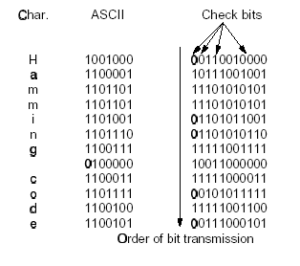
Extending Hamming Codes for Burst Errors
Data is arranged in a block
and the instead of transmitting
the bits of each symbol in turn,
bit 1 of each symbol is trans-
mitted, followed by bit 2 of
each symbol, and so on. If
there are n symbols in the block,
then a single burst error of up to
n bits will affect no more than one bit position in every Hamming code and hence can be corrected
© Tanenbaum, Prentice Hall International
Note: Tanenbaum uses an unconventional bit order (bit 1 leftmost)

Slide 24
Forward Error Correction v ARQ
FEC requires a higher level of redundancy than ARQ
FEC cannot recover correctly from multiple burst errors and hence there is a much higher residual error rate
ARQ can make use of very powerful (CRC) error detecting codes and can detect virtually all errors
The delay caused by retransmitting is preferable to residual errors in most applications
FEC tends to be used mainly when there is no return channel (E.g. Teletext) or in real-time applications (E.g. Video on Demand) or over unreliable media

Slide 25
Example 1
Suppose that an error occurred during the transmission of the even Hamming Code 101111010111 of a binary code. Correct the error bit and write down the original binary code (without parity bits) which was meant to send.

Slide 26
Example 1 - Solution
 | 12 | 11 | 10 | 9 | 8 | 7 | 6 | 5 | 4 | 3 | 2 | 1 | To Fix
 | 1 | 0 | 1 | 1 | 1 | 1 | 0 | 1 | 0 | 1 | 1 | 1
B1 |  | 0 |  | 1 |  | 1 |  | 1 |  | 1 |  | 1 | 1
B2 |  | 0 | 1 |  |  | 1 | 0 |  |  | 1 | 1 |  | 0
B4 | 1 |  |  |  |  | 1 | 0 | 1 | 0 |  |  |  | 1
B8 | 1 | 0 | 1 | 1 | 1 |  |  |  |  |  |  |  | 0
Bits 1 and 4 are the wrong parity (underlined)
and bit 5 is the error as it is covered by bits 1 and 4
Alternatively, error is in bit position 5 = 0101₂ = 1 + 4
The original code that was sent was 10111001

Slide 27
Example 2
Suppose that an error occurred during the transmission of the odd Hamming Code 010101101110 of a binary code. Correct the error bit and write down the original binary code (without parity bits) which was meant to send.

Slide 28
Example 2 - Solution
 | 12 | 11 | 10 | 9 | 8 | 7 | 6 | 5 | 4 | 3 | 2 | 1 | To Fix
 | 0 | 1 | 0 | 1 | 0 | 1 | 1 | 0 | 1 | 1 | 1 | 0
B1 |  | 1 |  | 1 |  | 1 |  | 0 |  | 1 |  | 0 | 1
B2 |  | 1 | 0 |  |  | 1 | 1 |  |  | 1 | 1 |  | 0
B4 | 0 |  |  |  |  | 1 | 1 | 0 | 1 |  |  |  | 0
B8 | 0 | 1 | 0 | 1 | 0 |  |  |  |  |  |  |  | 1
Bits 1 and 8 are the wrong parity (underlined)
and bit 9 is the error as it is covered by bits 1 and 8
Alternatively, error is in bit position 9 = 1001₂ = 1 + 8
The original code that was sent was 01001101

Slide 29
Exercise 1 (from Study Guide)
The EBCDIC character B is encoded as 11000010. It is transmitted using an even Hamming code. What code is transmitted?
The character is received with a one bit error as 110001010010. Show how the bit in error can be corrected to recover the original data (without parity bits)

Slide 30
Exercise 1 – Solution (coding)
 | 12 | 11 | 10 | 9 | 8 | 7 | 6 | 5 | 4 | 3 | 2 | 1
 | 1 | 1 | 0 | 0 |  | 0 | 0 | 1 |  | 0
B1 |  | 1 |  | 0 |  | 0 |  | 1 |  | 0 |  | 0
B2 |  | 1 | 0 |  |  | 0 | 0 |  |  | 0 | 1
B4 | 1 |  |  |  |  | 0 | 0 | 1 | 0
B8 | 1 | 1 | 0 | 0 | 0
The EBCDIC Character B is transmitted as 110000010010 as an
even Hamming Code

Slide 31
Exercise 1 – Solution (decoding)
 | 12 | 11 | 10 | 9 | 8 | 7 | 6 | 5 | 4 | 3 | 2 | 1 | To Fix
 | 1 | 1 | 0 | 0 | 0 | 1 | 0 | 1 | 0 | 0 | 1 | 0
B1 |  | 1 |  | 0 |  | 1 |  | 1 |  | 0 |  | 0 | 1
B2 |  | 1 | 0 |  |  | 1 | 0 |  |  | 0 | 1 |  | 1
B4 | 1 |  |  |  |  | 1 | 0 | 1 | 0 |  |  |  | 1
B8 | 1 | 1 | 0 | 0 | 0 |  |  |  |  |  |  |  | 0
Bits 1, 2 and 4 are the wrong parity (underlined)
and bit 7 is the error as it is covered by bits 1, 2 and 4
Alternatively, error is in bit position 7 = 0111₂ = 1 + 2 + 4
The original code that was sent was 11000010

